Slide 1
Create Sentiment Analysis Model of English-Language Twitter Tweets Concerning COVID-19 During the Course of April 2020
Melinda Liu

Slide 2
Problem
COVID-19 is an infectious disease caused by the severe acute respiratory syndrome coronavirus 2 (SARS-CoV-2) that primarily affects the lungs but can also negatively affect other organs like the heart, kidneys, and brain, causing a multitude of other health complications that can leave a lasting impact.
Besides taking a toll on medical health, it is indicated that the COVID-19 pandemic is also taking a toll on mental and social health, especially due to the stay-at-home orders.

Slide 3
Benefits of Project
Give mental healthcare workers and sociologists insights on how the COVID-19 pandemic situation is affecting the mental health of the populace.
Give indications on how resources of psychological care could be distributed and utilized to mitigate any negative effects long-term pandemics and lockdowns may have on emotional health.

Slide 4
Aim of Project
Predict sentiment towards the COVID-19 pandemic during the course of April 2020.
Plan: Create a sentiment analysis model from the English-language, coronavirus disease 2019 (COVID-19) Tweets. The sentiment labels are positive, neutral, and negative and will be created by the sentiment function of Python’s TextBlob package.

Slide 5
Data
Created by Shane Smith
https://www.kaggle.com/smid80
Download Links:
Main Page: https://www.kaggle.com/smid80/coronavirus-covid19-tweets
Early April: https://www.kaggle.com/smid80/coronavirus-covid19-tweets-early-april
Late April: https://www.kaggle.com/smid80/coronavirus-covid19-tweets-late-april

Slide 6
Data Merging and Cleaning
Concatenated together multiple csv files containing COVID-19 tweets pertaining to each day from March 29, 2020 to April 30, 2020 via the glob module into one pandas dataframe denoted as df_tweets
Dropped rows in which the Tweet text was not in English
Removed columns based on 60% missing (null) percentage criteria and whether or not the columns would contribute to data exploration and the main purpose of this project
Randomly dropped 90% of the rows due to the limited computational power of hardware

Slide 7
Data Merging and Cleaning
Converted emoticons to text
Examples:
:) : happy / smile
:( : frown / sad / pouting
Convert contractions into their basic words
Examples:
aren’t : are not / am not
can’t : cannot
can't’ve : cannot have

Slide 8
Data Merging and Cleaning
Removed url links and Twitter handles (@user)
Converted emojis into text before
Text from text column were lowercased, lemmatized, and stemmed with the non-alphabetical text, whitespaces, and stop words removed and denoted to new column called cleaned_text.

Slide 9
Data Merging and Cleaning
14 columns and 813,378 rows in final df_tweets dataframe
Columns: created_at (date and time of the Tweet), screen_name (screen name of the account that Tweeted), text (text of the Tweet), source (type of app used), is_quote (whether this Tweet is a quote of another Tweet), is_retweet (whether this Tweet is a retweet), favourites_count (number of favourites this Tweet has received), retweet_count (number of times this Tweet has been retweeted), followers_count (number of followers of the account that Tweeted), friends_count (number of friends of the account that Tweeted), account_created_at (date and time that the account that Tweeted was created), verified (whether the account that Tweeted is verified), lang (language of the Tweet), and cleaned_text (cleaned text under text column)

Slide 10
Initial Findings

Slide 11
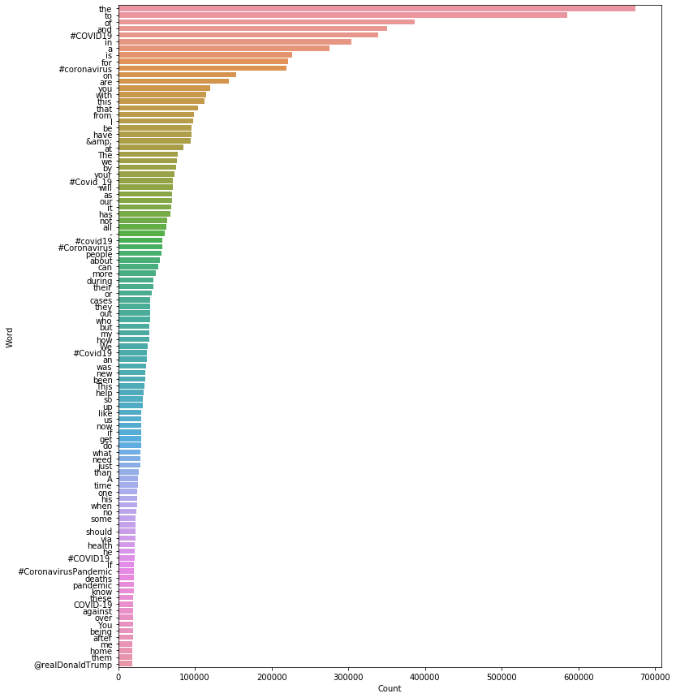
Figure 1: 100 Most Frequent Words of “text" in df_tweets

Slide 12
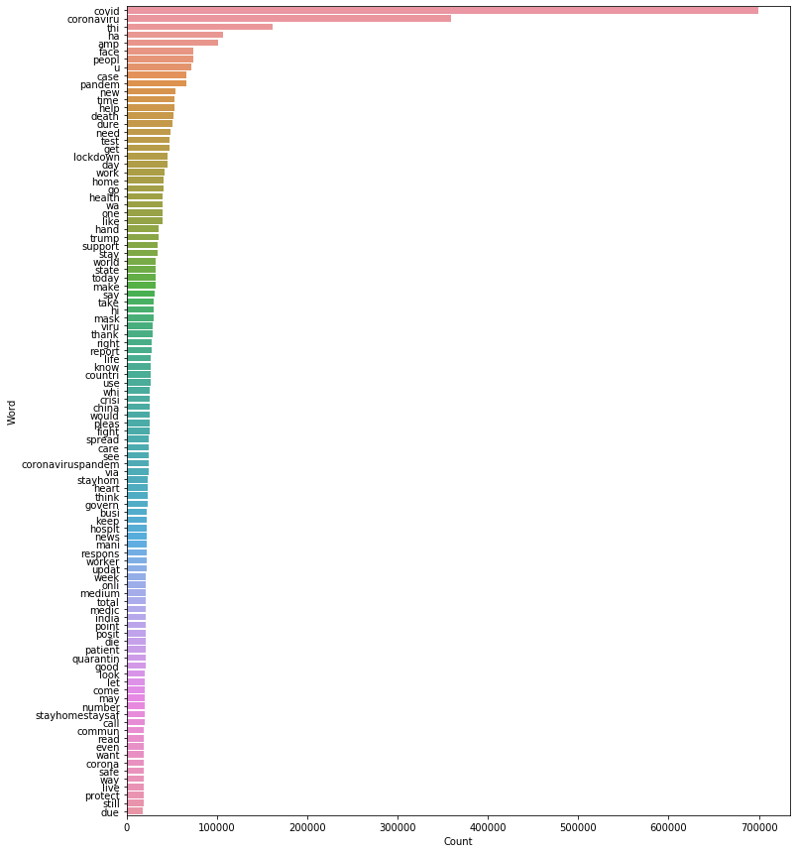
Figure 2: 100 Most Frequent Words of "cleaned_text" in df_tweets

Slide 13
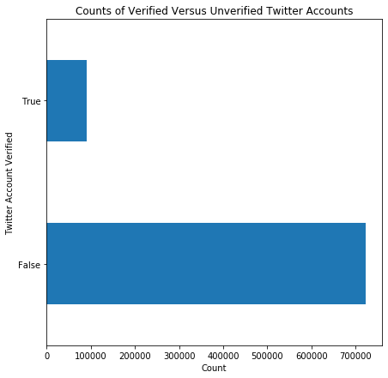
Figure 3:

Slide 14
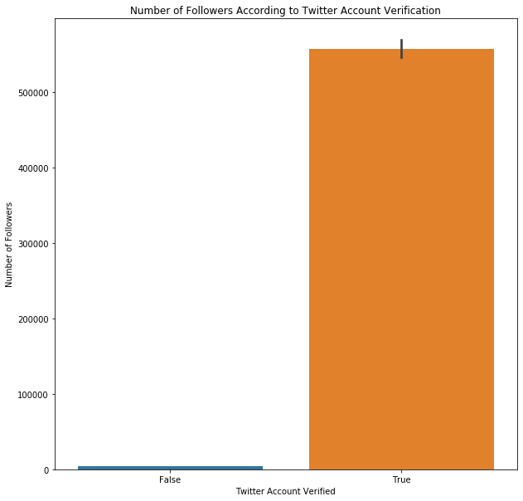
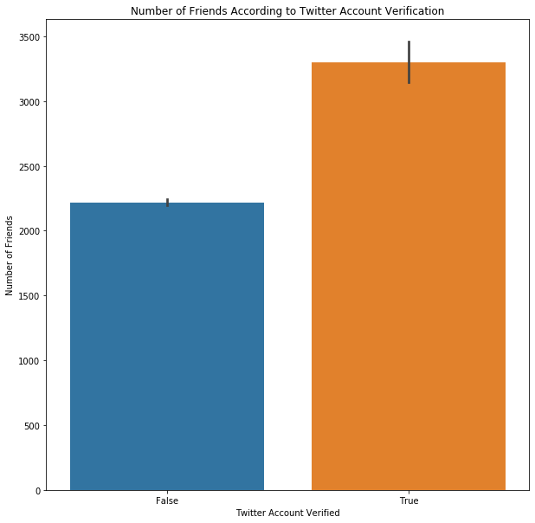
Figure 4 & 5:

Slide 15
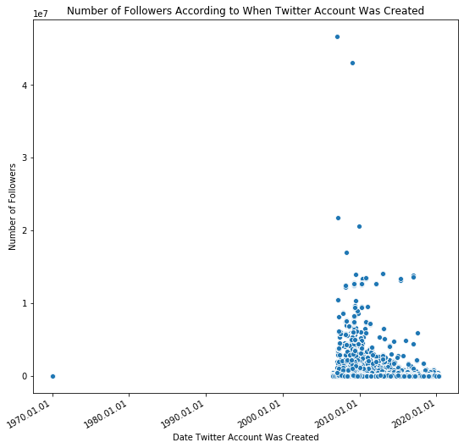
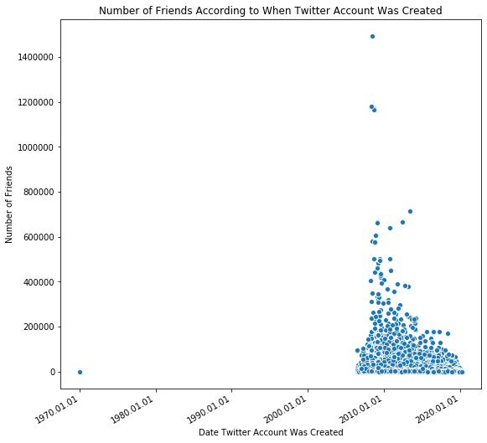
Figure 6 & 7:

Slide 16
Statistical Data Analysis
K-Means clustering
K-Means clustering handles big data well due to its linear time complexity.
TF-IDF (term frequency–inverse document frequency) values computed to vectorize the text of the cleaned_text column in order to create the features and X matrices for K-Means clustering algorithm to analyze.

Slide 17
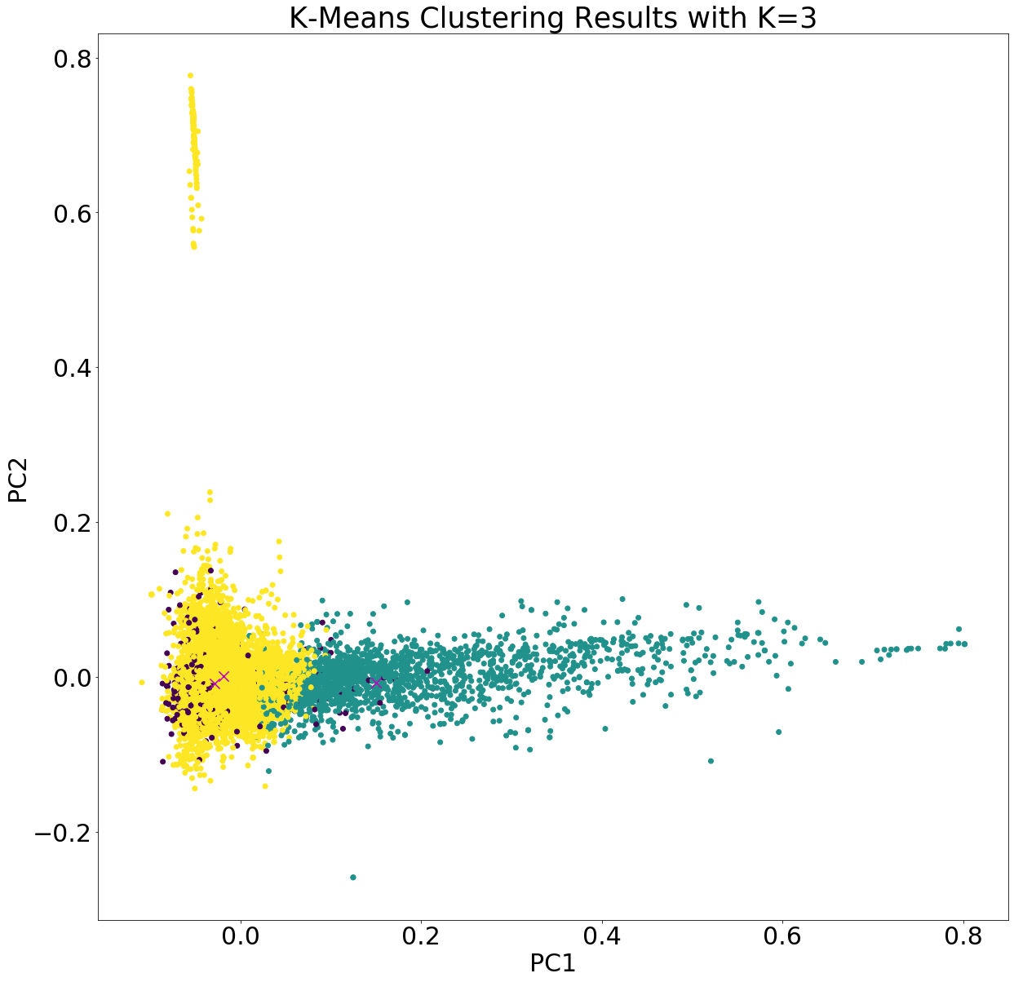
Figure 8:

Slide 18
K-Means inference
Silhouette Coefficient
Used to evaluate K-Means clustering results as text under the cleaned_text column in the df_tweets dataset is unlabeled for sentiment
Best value is 1 while worst value is -1
Values near 0 indicate overlapping clusters
Calculated Value: 0.0017
Indicates the clusters very much overlap rather than being distinct from each other.
K-Means clustering indicates the text under the cleaned_text column lack any distinct classifications.

Slide 19
Create Sentiment Labels

Slide 20
Create Sentiment Labels in Dataset
Utilized sentiment function from Python’s TextBlob package to make sentiment labels and save them in a new column called sentiment in df_tweets dataset
Polarity score: float within the range [-1.0, 1.0] where 1 means positive statement and -1 means negative statement
Subjectivity score: float within the range [0.0, 1.0] where 0.0 is very objective and 1.0 is very subjective

Slide 21
Create Sentiment Analysis Model

Slide 22
Preparing Data for Sentiment Analysis Model
Utilized multi-label classification in NLP to create sentiment analysis model
Text data and target variable needed to be converted into features and formats respectively.
Text Data: cleaned_text column of df_tweets dataset
Target Variable: sentiment column of df_tweets dataset
Create three different sentiment analysis models to see if Naive Bayes Classifier for Multinomial Models, Linear Support Vector Machine, or Logistic Regression would be the best to analyze the data for this project

Slide 23
Formatting target variable Via one-hot encoding by sklearn’s MultiLabelBinarizer function
#Converting values in target variable into lists y = df_tweets['sentiment'].str.split()
#One hot encode the target variable by using sklearn’s MultiLabelBinarizer( ) multilabel_binarizer = MultiLabelBinarizer()
multilabel_binarizer.fit(y)
MultiLabelBinarizer(classes=None, sparse_output=False)
# transform target variable
y = multilabel_binarizer.transform(y)

Slide 24
Splitting training and validation sets of Corpus and target variable
# split dataset into training and validation set
xtrain, xval, ytrain, yval = train_test_split(df_tweets['cleaned_text'], y, test_size=0.2, random_state=42)

Slide 25
train and Validation sets of the Corpus were converted into TF-IDF features
#Using TF-IDF to extract features from the cleaned version of the text data tfidf_vectorizer = TfidfVectorizer(max_df=0.8, max_features=10000) # set 10,000 most frequent words in the data as features
#Create TF-IDF features xtrain_tfidf = tfidf_vectorizer.fit_transform(xtrain)
xval_tfidf = tfidf_vectorizer.transform(xval)

Slide 26
Create Sentiment Analysis models
TF-IDF and Naive Bayes Classifier for Multinomial Models with OneVsRestClassifier
#Use sklearn’s OneVsRestClassifier class to solve the Naive Bayes Classifier model's problem as a Binary Relevance or one-vs-all problem
nb = MultinomialNB()
clf_nb = OneVsRestClassifier(nb)
#Fit model on TF-IDF train data
clf_nb.fit(xtrain_tfidf, ytrain)
#Make predictions for validation set
y_pred_tfidf_nb = clf_nb.predict(xval_tfidf)

Slide 27
Create Sentiment Analysis models
TF-IDF and Linear Support Vector Machine with OneVsRestClassifier
#Use sklearn’s OneVsRestClassifier class to solve the Linear Support Vector Machine model's problem as a Binary Relevance or one-vs-all problem
lsvm = SGDClassifier(loss='hinge', penalty='l2',alpha=1e-3, random_state=42, tol=None)
clf_lsvm = OneVsRestClassifier(lsvm)
#Fit model on TF-IDF train data
clf_lsvm.fit(xtrain_tfidf, ytrain)
#Make predictions for validation set
y_pred_tfidf_lsvm = clf_lsvm.predict(xval_tfidf)

Slide 28
Create Sentiment Analysis models
TF-IDF and Logistic Regression with OneVsRestClassifier
#Use sklearn’s OneVsRestClassifier class to solve the Logistic Regression model's problem as a Binary Relevance or one-vs-all problem
lr = LogisticRegression(max_iter = 4000)
clf_lr = OneVsRestClassifier(lr)
#Fit model on TF-IDF train data
clf_lr.fit(xtrain_tfidf, ytrain)
#Make predictions for validation set
y_pred_tfidf_lr = clf_lr.predict(xval_tfidf)

Slide 29
Evaluate Sentiment Analysis Models
All of the predictions and the entire target variable of the validation set taken into consideration
Utilized metrics of the confusion matrix for multi-class classification
F1 score: weighted average of the precision and recall where 1 is best score and 0 is worst score
Emphasized micro, macro, and weighted F1-scores to determine which model was best to analyze the data used for this project

Slide 30
Evaluate Sentiment Analysis Models
Micro F1-score: calculated by considering the total TP (true positives), total FP (false positives), and total FN (false negatives) of the confusion matrix of the model; calculates the metrics globally and does not consider each class individually
Macro F1-score: calculates metrics for each class (sentiment label in this case) individually and then takes unweighted mean of the measures; calculates the precision, recall, and micro F1-score for each class
Weighted F1-score: takes weighted mean of the measures; weights for each class are the total number of samples of that class.

Slide 31
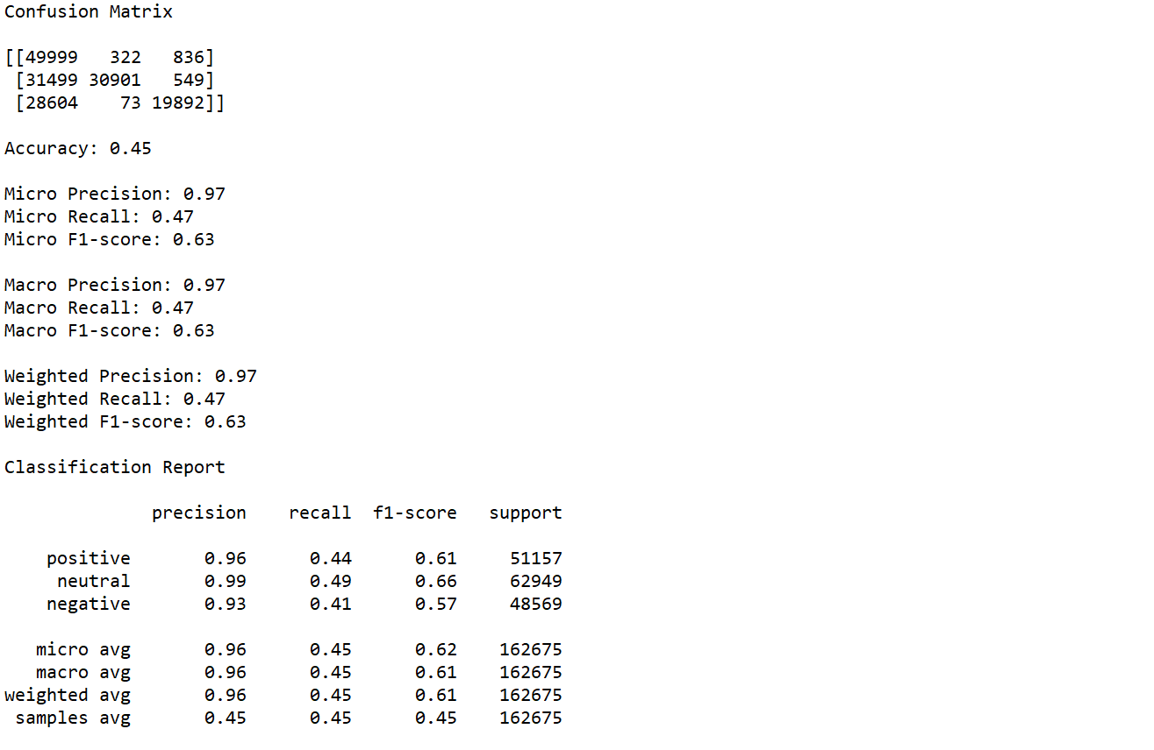
Naive Bayes Classifier for Multinomial Models with OneVsRestClassifier Model

Slide 32
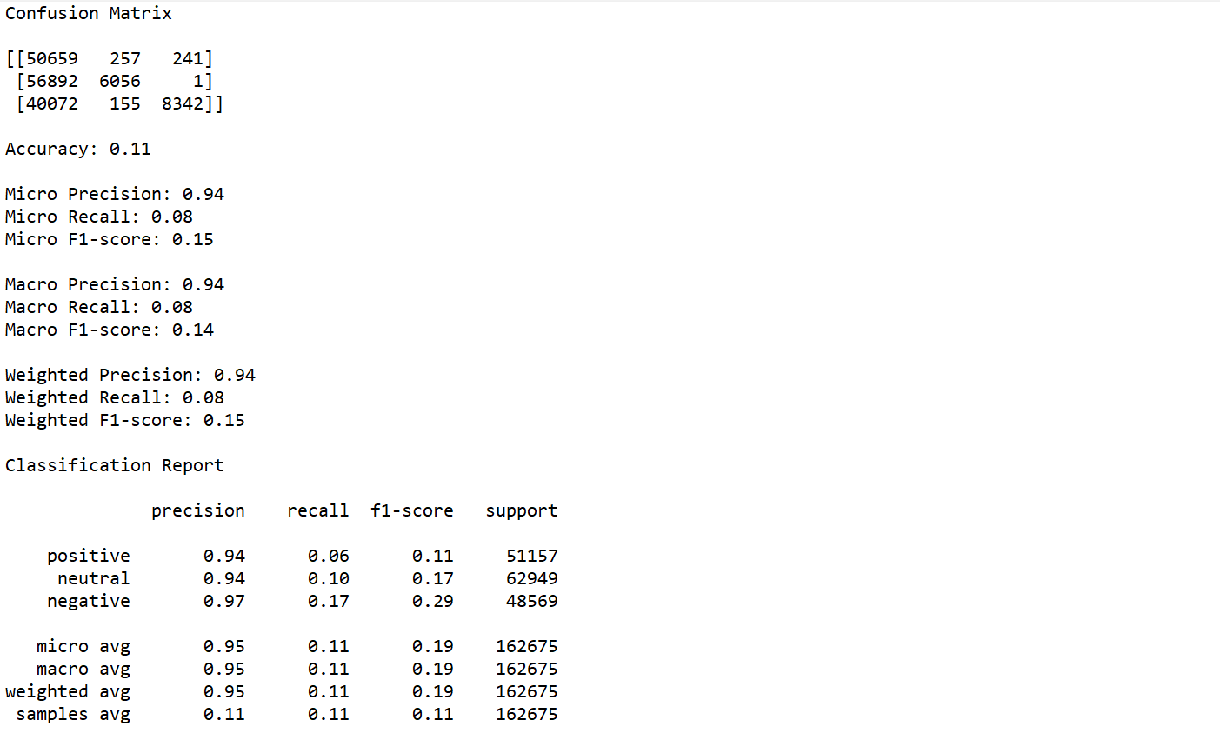
Linear Support Vector Machine with OneVsRestClassifier Model

Slide 33
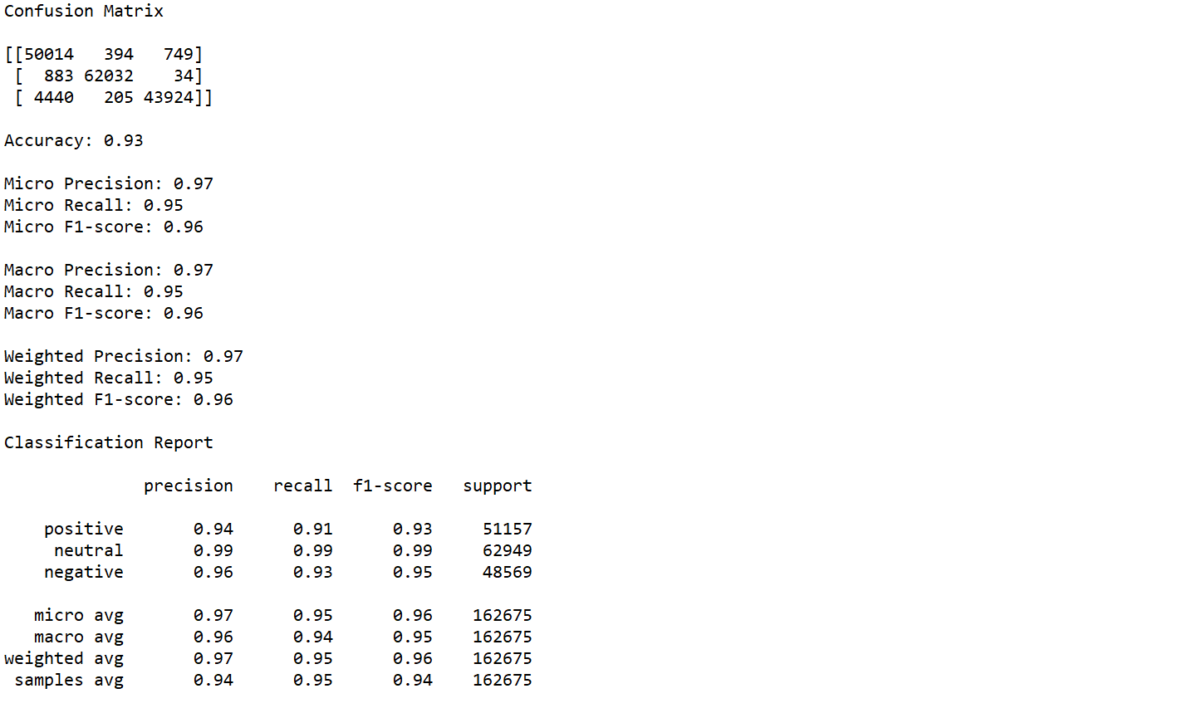
Logistic Regression with OneVsRestClassifier Model

Slide 34
Evaluate Sentiment Analysis Models
Naive Bayes Classifier for Multinomial Models with OneVsRestClassifier Model
Micro F1-score: 0.63
Macro F1-score: 0.63
Weighted F1-score: 0.63
Linear Support Vector Machine with OneVsRestClassifier Model
Micro F1-score: 0.15
Macro F1-score: 0.14
Weighted F1-score: 0.15

Slide 35
Evaluate Sentiment Analysis Models
Logistic Regression with OneVsRestClassifier Model
Micro F1-score: 0.96
Macro F1-score: 0.96
Weighted F1-score: 0.96

Slide 36
Post Statistical Analysis

Slide 37
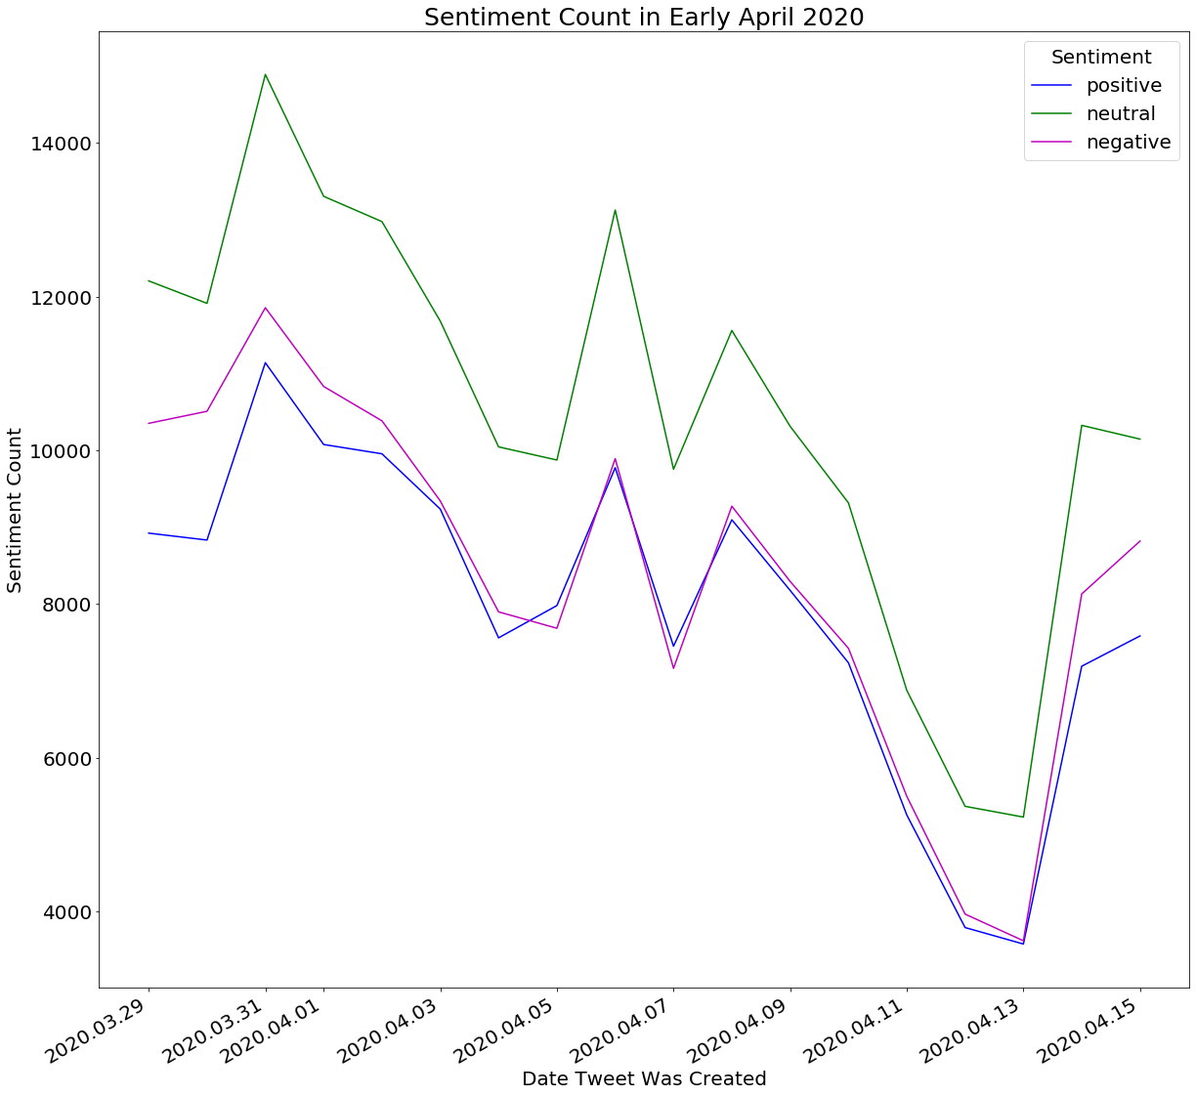
Figure 9:

Slide 38
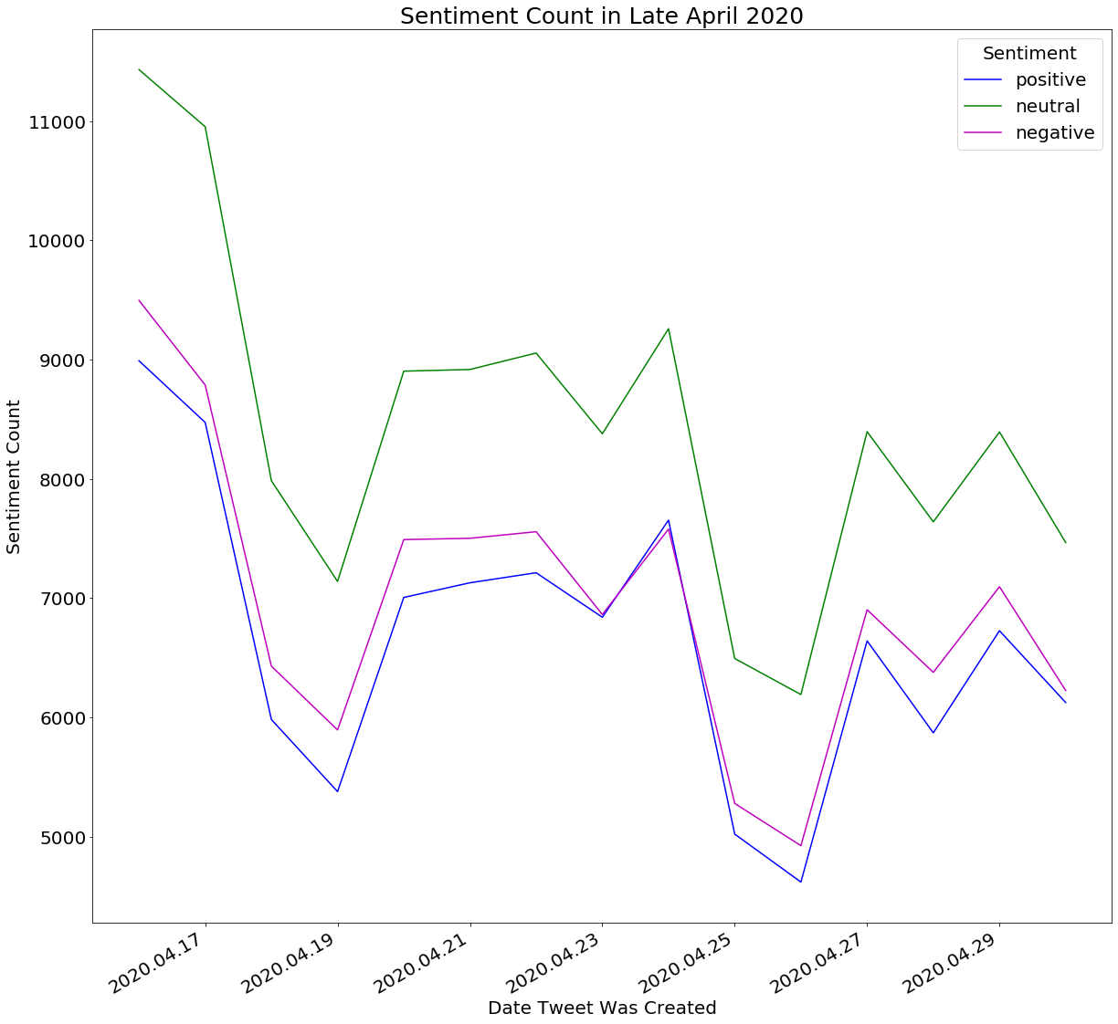
Figure 10:

Slide 39
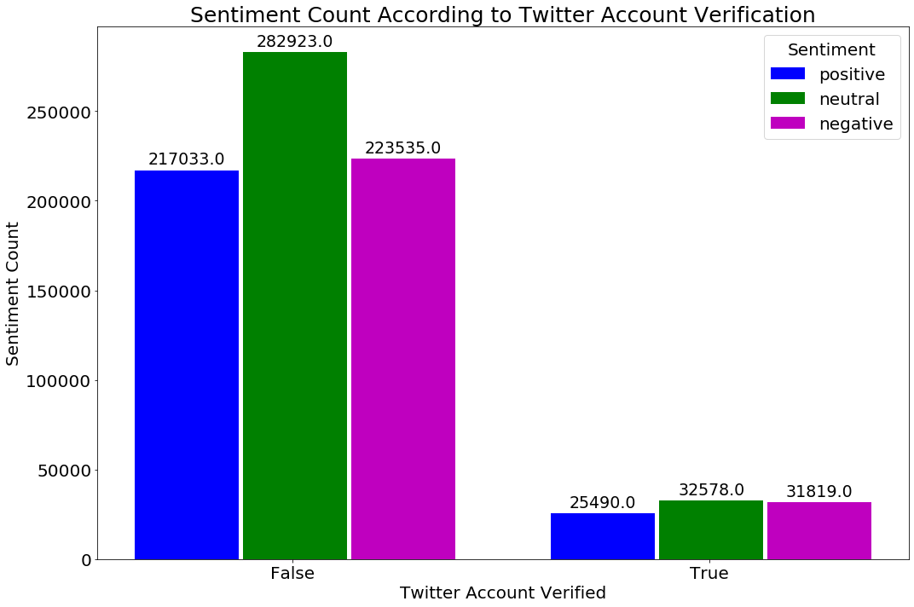
Figure 11:

Slide 40
Discussion

Slide 41
Project Limitations
Limitations for sentiment analysis model to analyze Tweets written in non-English languages
Different grammatical structures for different languages
Uncleanable Tweet text in different formats.
Ex. 𝖎 𝖆𝖒 𝖑𝖊𝖆𝖗𝖓𝖎𝖓𝖌 𝖓𝖊𝖜 𝖜𝖆𝖞 𝖔𝖋 𝖙𝖜𝖊𝖊𝖙𝖎𝖓𝖌 #𝕮𝖔𝖗𝖔𝖓𝖆𝖁𝖎𝖗𝖚𝖘 #𝕷𝖔𝖈𝖐𝖉𝖔𝖜𝖓
A number of misclassifications by sentiment function from Python’s TextBlob package
Ex. “whitehous project devast covid death toll” being labeled as neutral

Slide 42
Potential Improvements for Project
Possible to create a function to convert Tweet text in different formats back into the standardized text format?
Perhaps dictionaries categorizing words and phrases as positive, negative, and neutral would give better accuracy for sentiment labeling?
Might it be possible to train sentiment analysis model to incorporate different languages as well as fine-grained sentiments such as angry, sad, happy, sarcasm, etc.?

